Slide 1


Largest Rectangle in Histogram
This presentation will guide you through finding the largest rectangular area in a histogram represented by an array. We'll explore different approaches, from brute force to optimized stack-based solutions, and analyze their complexities. Let's dive in!
by Anusha S

Slide 2
Brute Force Approach (O(N²))
Approach
Code
Iterate over each bar and extend the rectangle to the left and right while maintaining the minimum height. Compute the maximum area.
public static int largestRectangleAreaBruteForce(int[] heights) {
int n = heights.length;
int maxArea = 0;
for (int i = 0; i < n; i++) {
int minHeight = heights[i];
for (int j = i; j < n; j++) {
minHeight = Math.min(minHeight, heights[j]);
int width = j - i + 1;
maxArea = Math.max(maxArea, minHeight * width);
}
}
return maxArea;
}
Time Complexity: O(N²). Not optimal for large inputs. Space Complexity: O(1). No extra space used.

Slide 3

Optimized Approach using Stack (O(N))
1
Concept
2
Algorithm
Find the Next Smaller Element (Right) for each bar. Find the Previous Smaller Element (Left) for each bar. Compute the width of the largest rectangle for each bar and find the maximum.
Use a stack to find the next smaller element (right) for each bar. Use another stack to find the previous smaller element (left) for each bar. Compute the width as right[i] - left[i] - 1. Compute the area as height * width and return the maximum.

Slide 4
Java Code (Optimized Using Stack)
import java.util.Stack;
class LargestRectangleHistogram {
public static int largestRectangleArea(int[] heights) {
int n = heights.length;
Stack<Integer> stack = new Stack<>();
int maxArea = 0;
for (int i = 0; i <= n; i++) {
int currentHeight = (i == n) ? 0 : heights[i];
while (!stack.isEmpty() && currentHeight < heights[stack.peek()]) {
int height = heights[stack.pop()];
int width = stack.isEmpty() ? i : i - stack.peek() - 1;
maxArea = Math.max(maxArea, height * width);
}
stack.push(i);
}
return maxArea;
}
public static void main(String[] args) {
int[] arr1 = {60, 20, 50, 40, 10, 50, 60};
System.out.println(largestRectangleArea(arr1));
int[] arr2 = {3, 5, 1, 7, 5, 9};
System.out.println(largestRectangleArea(arr2));
int[] arr3 = {3};
System.out.println(largestRectangleArea(arr3));
}
}

Slide 5
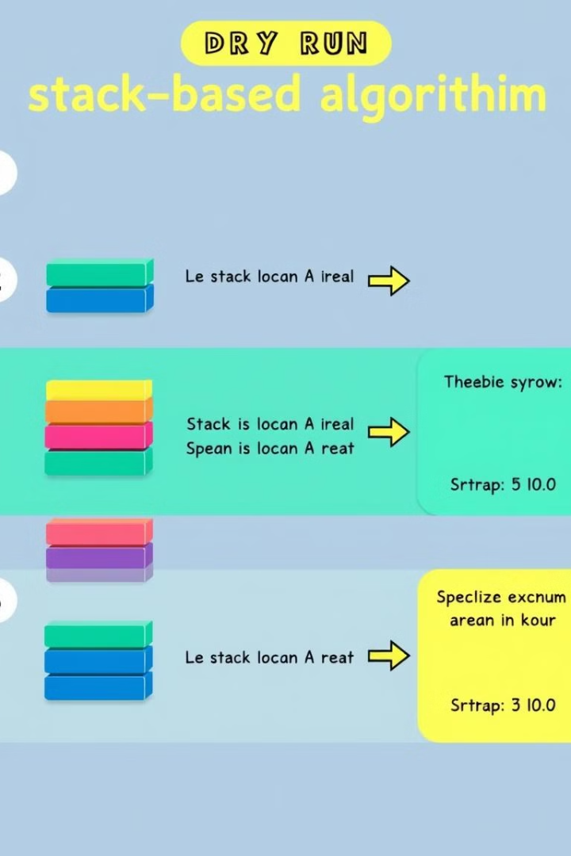
Dry Run for arr[] = [3, 5, 1, 7, 5, 9]
Index
Bar Height
Stack Action
Max Area Update
0
3
Push (0)
-
1
5
Push (1)
-
2
1
Pop (5), Pop (3)
maxArea = 5
3
7
Push (2), Push (3)
-
4
5
Pop (7)
maxArea = 7
5
9
Push (4), Push (5)
-
6
0 (Sentinel)
Pop (9), Pop (5), Pop (1)
maxArea = 15

Slide 6
Complexity Analysis
Time Complexity
Space Complexity
O(N). Each element is pushed/popped from the stack once.
O(N). Stack is used for storing indices.

Slide 7

Edge Cases to Consider
Single Bar (arr[] = [5])
All Same Height (arr[] = [2, 2, 2, 2])
Output: 5
Output: 2 × 4 = 8
Decreasing Heights (arr[] = [9, 7, 5, 3, 1])
Output: 9

Slide 8

Alternative Approach Using Two Arrays
Instead of a stack, we can use two precomputed arrays:
left[] → Stores indices of previous smaller elements.
right[] → Stores indices of next smaller elements.
This approach runs in O(N) time but uses extra space O(N).

Slide 9
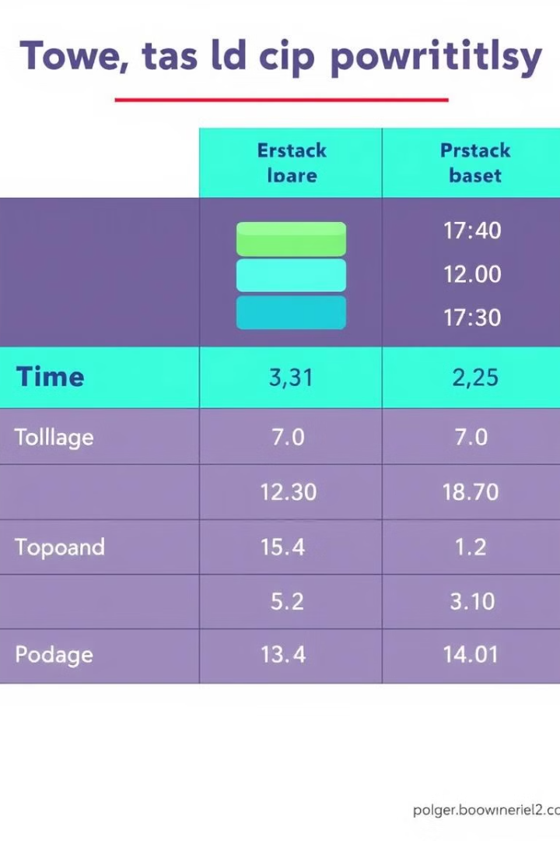
Summary of Solution
Approach
Time Complexity
Space Complexity
Brute Force
O(N²)
O(1)
Stack-Based
O(N)
O(N)
Two Arrays
O(N)
O(N)
✅ The stack-based approach is the most efficient. 🚀

Slide 10

Key Takeaways
1
Stack
Use a stack to find previous and next smaller elements in O(N) time.
2
Width
Compute width as right[i] - left[i] - 1 for each bar.
3
Max Area
Find max area using height * width.
4
Sentinel
Use a sentinel 0 at the end to ensure all bars are processed.

